Slide 1

Advanced Training Strategies: Pyramid Scheme
Genetic Programming
By Thanushan Pirapakaran, Adrian Binu, Brett Terpstra

Slide 2
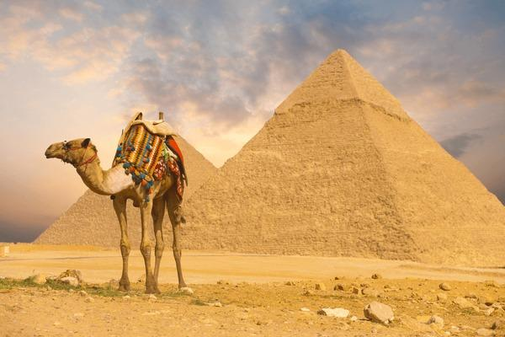
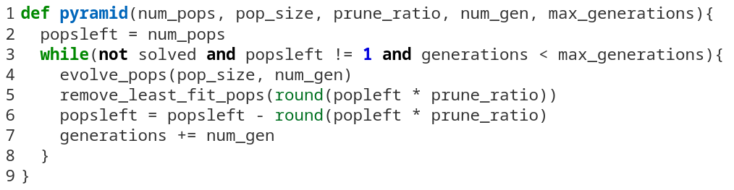
Pseudo Code

Slide 3
num_pop = 5
pop_size = 50
prune_ratio = 0.1
num_gen = 10
50th gen
40th gen
30th gen
20th gen
10th gen
Pop. 1
Fittest: 2
Pop. 2
Fittest: 5
Pop. 3
Fittest: 10
Pop. 4
Fittest: 9
Pop. 5
Fittest: 3

Slide 4
num_pop = 5
pop_size = 50
prune_ratio = 0.1
num_gen = 10
Number of populations to prune
= round(pr*np) = 1
50th gen
40th gen
30th gen
20th gen
Pop. 2
Fittest: 5
Pop. 3
Fittest: 11
Pop. 4
Fittest: 9
Pop. 5
Fittest: 4
10th gen
Pop. 1
Fitness: 2
Pop. 2
Fittest: 5
Pop. 3
Fittest: 10
Pop. 4
Fittest: 9
Pop. 5
Fittest: 3

Slide 5
num_pop = 5
pop_size = 50
prune_ratio = 0.1
num_gen = 10
Number of populations to prune
= round(pr*np) = 1
50th gen
40th gen
30th gen
Pop. 2
Fittest: 15
Pop. 3
Fittest: 11
Pop. 4
Fittest: 12
20th gen
Pop. 2
Fittest: 5
Pop. 3
Fittest: 11
Pop. 4
Fittest: 9
Pop. 5
Fittest: 4
10th gen
Pop. 1
Fitness: 2
Pop. 2
Fittest: 5
Pop. 3
Fittest: 10
Pop. 4
Fittest: 9
Pop. 5
Fittest: 3

Slide 6
num_pop = 5
pop_size = 50
prune_ratio = 0.1
num_gen = 10
Number of populations to prune
= round(pr*np) = 1
50th gen
40th gen
Pop. 2
Fittest: 15
Pop. 4
Fittest: 16
30th gen
Pop. 2
Fittest: 15
Pop. 3
Fittest: 11
Pop. 4
Fittest: 12
20th gen
Pop. 2
Fittest: 5
Pop. 3
Fittest: 11
Pop. 4
Fittest: 9
Pop. 5
Fittest: 4
10th gen
Pop. 1
Fitness: 2
Pop. 2
Fittest: 5
Pop. 3
Fittest: 10
Pop. 4
Fittest: 9
Pop. 5
Fittest: 3

Slide 7
num_pop = 5
pop_size = 50
prune_ratio = 0.1
num_gen = 10
Number of populations to prune
= round(pr*np) = 1
50th gen
Pop. 4
Fittest: 20
40th gen
Pop. 2
Fittest: 15
Pop. 4
Fittest: 16
30th gen
Pop. 2
Fittest: 15
Pop. 3
Fittest: 11
Pop. 4
Fittest: 12
20th gen
Pop. 2
Fittest: 5
Pop. 3
Fittest: 11
Pop. 4
Fittest: 9
Pop. 5
Fittest: 4
10th gen
Pop. 1
Fitness: 2
Pop. 2
Fittest: 5
Pop. 3
Fittest: 10
Pop. 4
Fittest: 9
Pop. 5
Fittest: 3

